Slide 1
UNIT 2
Introduction to
Web Servers &
Node.js Development
Full Stack Development | MC02094041 | MCA Semester 2 | GTU
Topics: Web Servers • Node.js • NPM • HTTP Module • Express • EJS • Static Files • async/await • JSON APIs

Slide 2
Unit 2 — What We Will Learn
Overview
1
2
3
🌐 Web Servers
⚡ Node.js
📦 NPM
How websites work, HTTP, Client-Server
Running JS outside the browser
Managing packages & libraries
4
5
6
🖥️ HTTP Module
🚀 Express.js
🎨 EJS Templates
Building a server from scratch
Fast routing & web framework
Dynamic HTML on the server
7
8
9
📁 Static Files
⏳ async/await
📡 JSON APIs
Serving CSS, images, JS files
Clean asynchronous code
Sending & receiving data as JSON
MC02094041 – Full Stack Development | MCA Sem 2 | GTU

Slide 3
UNIT 2 | Topic 1
Introduction to Web Servers
How the internet works — clients, servers, and HTTP
MC02094041 – Full Stack Development | MCA Sem 2 | GTU

Slide 4
What is a Web Server?
Topic 1 › Web Servers
📖 Definition: Web Server
A web server is a software program that runs continuously on a computer and is responsible for accepting incoming HTTP requests from clients (browsers), processing those requests, and sending back appropriate HTTP responses — such as HTML pages, images, or JSON data.
🌍 Real-World Analogy — Think of a Restaurant:
YOU (browser) = customer who places an order | WAITER = HTTP protocol that carries the order | KITCHEN = server that processes the order | FOOD = the response (HTML/JSON) served back to you
💡 Note: Examples of web server software: Apache HTTP Server, Nginx, Microsoft IIS, and Node.js with the Express framework.
MC02094041 – Full Stack Development | MCA Sem 2 | GTU

Slide 5
Client-Server Architecture
Topic 1 › Web Servers
📖 Definition: Client-Server Architecture
A computing model where the CLIENT (browser) initiates requests and the SERVER listens, processes requests, and returns responses. This model is the foundation of how all web applications work on the internet.
🌐 CLIENT
🖥️ SERVER
• Web Browser
➜ HTTP Request
• Node.js / Express
GET /index.html
• Your Phone/Laptop
• Runs on a computer
• Sends HTTP Request
• Receives requests
• Displays Response
• Sends back data
◀ HTTP Response
200 OK + HTML page
MC02094041 – Full Stack Development | MCA Sem 2 | GTU

Slide 6
HTTP — The Language of the Web
Topic 1 › Web Servers
📖 Definition: HTTP (HyperText Transfer Protocol)
A set of rules that defines how data is exchanged between a client and a web server over the internet. HTTP is a request-response protocol — the client always sends a request first, and the server always sends a response back.
The 4 Most Important HTTP Methods:
GET
POST
PUT
DELETE
Fetch / Read Data
Send / Create Data
Update Existing Data
Remove Data
e.g. Open a webpage, load students list
e.g. Submit a form, register a user
e.g. Edit profile, update a record
e.g. Delete a post, remove an account
MC02094041 – Full Stack Development | MCA Sem 2 | GTU

Slide 7
HTTP Status Codes
Topic 1 › Web Servers
📖 Definition: HTTP Status Code
A 3-digit number sent by the server in every response to indicate the outcome of the request. The first digit shows the category (1xx=Info, 2xx=Success, 3xx=Redirect, 4xx=Client Error, 5xx=Server Error).
Most Important Status Codes:
200 OK
Request successful
400 Bad Request
Client sent bad data
e.g. Page loaded correctly
e.g. Missing required field in form
201 Created
New resource created
401 Unauthorized
Login required
e.g. User registered successfully
e.g. Accessing page without logging in
404 Not Found
Resource doesn't exist
500 Server Error
Bug in server code
e.g. Wrong URL typed by user
e.g. Crash in Node.js/Express
MC02094041 – Full Stack Development | MCA Sem 2 | GTU

Slide 8
UNIT 2 | Topic 2
JavaScript with Node.js
Running JavaScript outside the browser — on the server
MC02094041 – Full Stack Development | MCA Sem 2 | GTU

Slide 9
What is Node.js?
Topic 2 › Node.js
📖 Definition: Node.js
Node.js is an open-source, cross-platform, server-side JavaScript runtime environment built on Google Chrome's V8 JavaScript engine. It allows developers to execute JavaScript code outside of a web browser — directly on a computer or server — enabling JavaScript to be used for backend development.
Key Features of Node.js:
Open-Source
Cross-Platform
V8 Engine
Free to use; code is publicly available for anyone to see and contribute to
Runs on Windows, macOS, and Linux without any changes to the code
Uses Google Chrome's V8 engine — compiles JS to machine code for very fast execution
Non-Blocking I/O
Single-Threaded
Does NOT wait for slow operations — handles multiple requests simultaneously
Runs on one thread but uses the Event Loop to manage thousands of connections efficiently
MC02094041 – Full Stack Development | MCA Sem 2 | GTU

Slide 10
Examples
Topic 2 › Node.js
Non-Blocking I/O in Node.js
Imagine a user requests a file from the server. Reading a file takes time. In Node.js, when the file reading starts, the server does not wait for it to finish. Instead, it continues handling other user requests. When the file is ready, Node.js sends it back to the user. This means the server does not stop or block while waiting. It keeps working on other tasks. That is called Non-Blocking I/O.
Single-Threaded
Node.js uses only one main thread to execute JavaScript code. That means all requests are handled by one execution flow. But instead of creating multiple threads for multiple users, Node.js uses the Event Loop to quickly switch between tasks.
For example, if 100 users open a website at the same time, Node.js does not create 100 threads. It handles requests one by one very quickly using the same single thread, making it memory-efficient and scalable.
MC02094041 – Full Stack Development | MCA Sem 2 | GTU

Slide 11
Why Learn Node.js?
Topic 2 › Node.js
📖 Node.js
It Enables the use of JavaScript for both frontend and backend development.
It Supports building real-time applications like chat apps and gaming servers.
It Backed by a vibrant community and extensive library support
MC02094041 – Full Stack Development | MCA Sem 2 | GTU

Slide 12
Browser JavaScript vs Node.js — Side by Side
Topic 2 › Node.js
🌍 JS in Browser
⚡ JS with Node.js
✗ Runs inside Chrome / Firefox
✓ Runs on server / your computer
✗ Cannot read/write files
✓ Can read and write files
✗ Cannot create a web server
VS
✓ Can create a web server
✗ Cannot connect to database
✓ Can connect to databases
✗ Limited to browser APIs only
✓ Access to all OS features
✓ Can manipulate HTML (DOM)
✓ Can process requests & responses
MC02094041 – Full Stack Development | MCA Sem 2 | GTU

Slide 13
Installing Node.js & Your First Program
Topic 2 › Node.js
Installation Steps:
1
2
3
4
5
Go to nodejs.org
Download LTS version
Run installer
Verify in terminal
Start coding!
Code Example
Code Example
// Verify installation
node --version
npm --version
// Create file: hello.js
console.log('Hello Node.js!');
let name = 'Priya';
console.log('Hello, ' + name);
// Run in terminal:
node hello.js
// Output:
// Hello Node.js!
// Hello, Priya
💡 Note: LTS = Long Term Support. Always download LTS for stability. 'node filename.js' executes any JS file with Node.js.
MC02094041 – Full Stack Development | MCA Sem 2 | GTU

Slide 14
How Node.js Works — The Event Loop
Topic 2 › Node.js
📖 Definition: Event Loop
The Event Loop is the mechanism that enables Node.js to handle asynchronous operations without blocking. Instead of waiting for slow tasks (file reading, database queries), it registers callbacks and moves on, returning to handle results when ready.
🌍 Analogy — A Smart Restaurant Waiter:
SLOW (Blocking): Waiter takes order → stands at kitchen window waiting 10 min → delivers → takes next order. Very slow!
SMART (Non-blocking / Node.js): Waiter takes order 1 → gives it to kitchen → takes order 2 → takes order 3 → when order 1 is ready, kitchen notifies waiter → delivers. All customers served efficiently!
💡 Note: This is why Node.js can handle thousands of simultaneous connections with a single thread — it never sits idle waiting for one slow operation to finish.
Non-Blocking Flow:
1
2
3
4
5
6
Request arrives
Start operation
Register callback
Move to next request
Operation finishes
Run callback
MC02094041 – Full Stack Development | MCA Sem 2 | GTU

Slide 15
UNIT 2 | Topic 3
NPM — Node Package Manager
Install, manage, and share JavaScript libraries in one command
MC02094041 – Full Stack Development | MCA Sem 2 | GTU

Slide 16
What is NPM?
Topic 3 › NPM
📖 Definition: NPM (Node Package Manager)
NPM is a command-line tool that comes bundled with Node.js. It serves as both (1) a tool to install, update, and manage external code libraries called packages, and (2) the world's largest online registry of open-source JavaScript packages (npmjs.com) with over 2 million packages.
🌍 Analogy — App Store for Code:
Instead of building every feature from scratch, a developer can search for an existing package that already does the job and install it in one command. Need to send emails? There is a package. Need to hash passwords? There is a package. Need to connect to MongoDB? There is a package.
Most Common NPM Commands:
npm init -y
Create a new package.json with default settings
npm install express
Download & install the 'express' package
npm install nodemon --save-dev
Install as development-only dependency
npm install
Install ALL packages listed in package.json
npm uninstall express
Remove / uninstall a package
MC02094041 – Full Stack Development | MCA Sem 2 | GTU

Slide 17
The package.json File — Project Identity Card
Topic 3 › NPM
📖 Definition: package.json
A JSON configuration file at the root of every Node.js project. It stores project name, version, description, and most importantly — the complete list of all package dependencies. Running 'npm install' reads this file and installs everything listed automatically.
Code Example
name
Project name (lowercase, no spaces)
{
"name": "my-web-app",
"version": "1.0.0",
"description": "MCA Project",
"main": "app.js",
"scripts": {
"start": "node app.js",
"dev": "nodemon app.js"
},
"dependencies": {
"express": "^4.18.2",
"ejs": "^3.1.9"
},
"devDependencies": {
"nodemon": "^3.0.1"
}
}
version
Current version: major.minor.patch
main
Entry file Node.js runs to start app
scripts.start
Run with: npm start
scripts.dev
Run with: npm run dev
dependencies
Packages needed to run the app
devDependencies
Packages needed only during development
💡 Note: NEVER upload node_modules/ to GitHub! Add it to .gitignore. Others just run 'npm install' to recreate it.
MC02094041 – Full Stack Development | MCA Sem 2 | GTU

Slide 18
UNIT 2 | Topic 4
Serving Files with the HTTP Module
Node.js's built-in way to create web servers
MC02094041 – Full Stack Development | MCA Sem 2 | GTU

Slide 19
The Built-in HTTP Module
Topic 4 › HTTP Module
📖 Definition: http Module
A built-in Node.js core module (no installation needed) that provides low-level functionality to create HTTP web servers and make HTTP requests. It is the foundation on which all Node.js web frameworks including Express are built.
Code Example
require('http')
Import the built-in http module
const http = require('http');
const server = http.createServer(
function(request, response) {
// Runs on EVERY incoming request
response.writeHead(200, {
'Content-Type': 'text/html'
});
response.write('<h1>Hello!</h1>');
response.end(); // Must always call end()
}
);
server.listen(3000, function() {
console.log('Server running!');
});
createServer(fn)
Create server with request handler
request (req)
Contains all info about incoming request
response (res)
Used to send data back to client
writeHead(200,{})
Set status code & response headers
response.write()
Add content to the response body
response.end()
MUST call — signals response is complete
listen(3000)
Start server; listen on port 3000
MC02094041 – Full Stack Development | MCA Sem 2 | GTU

Slide 20
Understanding localhost and Port Numbers
Topic 4 › HTTP Module
📖 Definition: localhost
📖 Definition: Port Number
A special hostname that refers to YOUR OWN computer. It is always mapped to IP address 127.0.0.1. Used to test a server running locally before deploying to the internet.
A number (0–65535) identifying a specific service on a computer. Think of it as a door number in a large building — each service has its own door. Port 3000 is used for development.
Important Port Numbers:
Port 80
Default HTTP port — visiting http://www.example.com uses port 80 automatically
Port 443
Default HTTPS port — used for all encrypted/secure web traffic
Port 3000
Most commonly used during Node.js / Express development
Port 27017
Default port for MongoDB database
MC02094041 – Full Stack Development | MCA Sem 2 | GTU

Slide 21
UNIT 2 | Topic 5
Introduction to Express Framework
The most popular Node.js web framework
MC02094041 – Full Stack Development | MCA Sem 2 | GTU

Slide 22
What is Express.js?
Topic 5 › Express
📖 Definition: Express.js
Express.js is a minimal, fast, and unopinionated web application framework for Node.js. It is built on top of Node.js's built-in http module and provides a higher-level, cleaner API for creating web servers. 'Unopinionated' means it does not force any specific structure — developers have complete freedom to organise their application.
Why Use Express? — HTTP Module vs Express:
Code Example
Code Example
// RAW HTTP — messy routing
if (req.url === '/') {
res.end('<h1>Home</h1>');
} else if (req.url==='/about') {
res.end('<h1>About</h1>');
} else if (req.url==='/contact'){
res.end('<h1>Contact</h1>');
} else {
res.end('404 Not Found');
}
// Gets messy very fast!
// EXPRESS — clean routing
const app = express();
app.get('/', (req,res) => {
res.send('<h1>Home</h1>');
});
app.get('/about', (req,res) => {
res.send('<h1>About</h1>');
});
app.listen(3000); // Done!
MC02094041 – Full Stack Development | MCA Sem 2 | GTU

Slide 23
Routing in Express — Handling Different URLs
Topic 5 › Express
📖 Definition: Routing
Routing is the mechanism by which an Express application determines how to respond to a specific client request based on the URL path and HTTP method. Each route = a path + a method + a handler function.
Code Example
Quick Reference:
const express = require('express');
const app = express();
// Basic route — GET /
app.get('/', (req, res) => {
res.send('<h1>Home Page</h1>');
});
// Route PARAMETER — :id is dynamic
app.get('/student/:id', (req, res) => {
const id = req.params.id;
res.send('Student ID: ' + id);
});
// QUERY string — /search?name=priya
app.get('/search', (req, res) => {
const name = req.query.name;
res.send('Searching: ' + name);
});
app.listen(3000);
app.get(path, fn)
Handle GET requests for the given path
app.post(path, fn)
Handle POST requests (submit data)
app.put(path, fn)
Handle PUT requests (update data)
app.delete(path, fn)
Handle DELETE requests
:id — req.params.id
Route parameter — dynamic part of URL
?name=x — req.query.name
Query parameter — optional data after ?
res.send()
Send text or HTML back to client
res.json()
Send JSON data back to client
res.status(404)
Set HTTP status code in response
MC02094041 – Full Stack Development | MCA Sem 2 | GTU

Slide 24
Middleware in Express
Topic 5 › Express
📖 Definition: Middleware
A middleware is a function in Express that executes during the request-response cycle. It has access to req, res, and a next() function. Middleware can execute code, modify req/res, end the cycle, or call next() to pass control to the next middleware. It is used for logging, authentication, parsing data, etc.
Request → Middleware 1 → Middleware 2 → Route Handler → Response
Code Example
const express = require('express');
const app = express();
// MIDDLEWARE 1: Log every request
app.use(function(req, res, next) {
console.log(req.method + ' ' + req.url + ' at ' + new Date().toLocaleTimeString());
next(); // MUST call next() to continue to next middleware/route
});
// MIDDLEWARE 2: Built-in — parse incoming JSON request body
app.use(express.json());
app.get('/', (req, res) => res.send('Home page'));
app.listen(3000);
MC02094041 – Full Stack Development | MCA Sem 2 | GTU

Slide 25
UNIT 2 | Topic 6
Server-Side Rendering with EJS
Building dynamic HTML pages on the server using templates
MC02094041 – Full Stack Development | MCA Sem 2 | GTU

Slide 26
Server-Side Rendering & EJS Explained
Topic 6 › EJS
📖 Definition: Server-Side Rendering (SSR)
📖 Definition: EJS (Embedded JavaScript Templates)
A technique where the server generates complete HTML by combining an HTML template with dynamic data before sending it to the browser. The browser receives ready-to-display HTML — no extra processing needed.
A Node.js template engine that allows JavaScript to be embedded inside HTML files using special tags. EJS files look like HTML but have dynamic parts that get filled with real data on the server.
📖 Template engines
A template engine in Express.js is used to render dynamic HTML by injecting data into templates.
Popular engines like EJS, Pug, or Handlebars can be integrated with Express.
All engines have different syntax similar to HTML, but it helps to pass down dynamic values from express to HTML.
Set the engine using app.set('view engine', 'ejs') and specify the template folder with app.set('views', './views').
Render templates using res.render('templateName', { key: value }).
res.render('index', { title: 'Welcome', message: 'Hello World' });
Install the engine using npm (e.g., npm install ejs) and create templates with placeholders like <%= title %> for data insertion.
MC02094041 – Full Stack Development | MCA Sem 2 | GTU

Slide 27
Server-Side Rendering & EJS Explained
Topic 6 › EJS
📖 EJS
📖 EJS
EJS (Embedded JavaScript) is a simple templating engine for generating dynamic HTML pages.
It integrates JavaScript logic into HTML using special tags like <%= %>
Supports JavaScript features like loops, conditionals, & partials.
Escapes HTML by default to prevent injection, with options for unescaped output.
Widely used with Express.js for rendering views dynamically.
EJS Tags:
<%= value %>
OUTPUT tag
Inserts a value into HTML (HTML-escaped for safety)
<% code %>
SCRIPTLET tag
Runs JavaScript code — no output (loops, if/else, variables)
<%- html %>
RAW HTML tag
Inserts raw HTML without escaping — use carefully
<%# comment %>
COMMENT tag
Server-side comment — completely removed from output HTML
<%- include('file') %>
INCLUDE tag
Inserts another EJS file (reusable header, footer, etc.)
MC02094041 – Full Stack Development | MCA Sem 2 | GTU

Slide 28
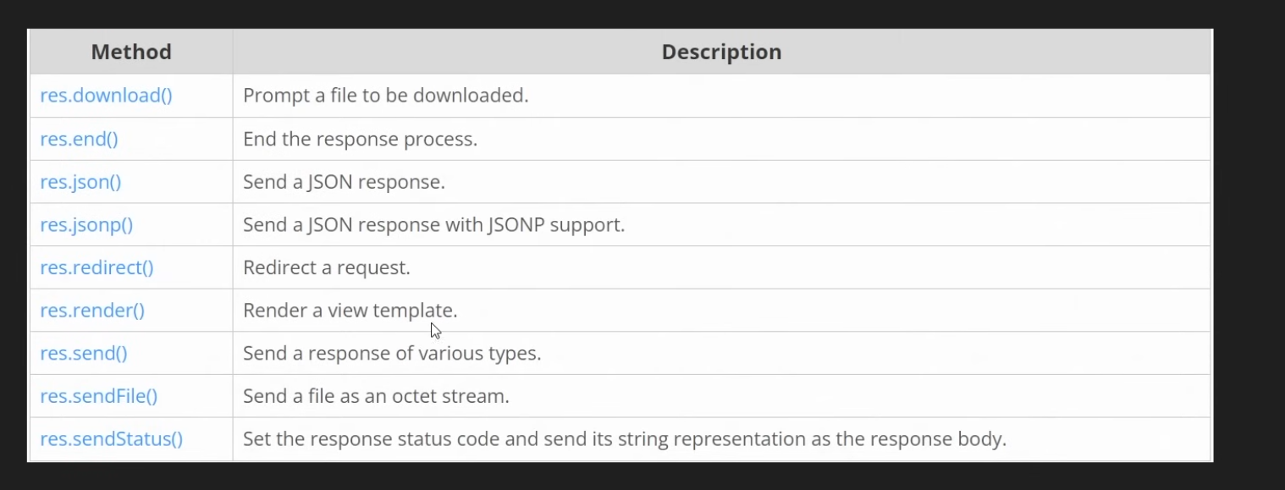

Slide 29
EJS in Action — Express Route + EJS Template
Topic 6 › EJS
Step 1 — Express Route (app.js):
Step 2 — EJS Template (views/result.ejs):
Code Example
Code Example
const express = require('express');
const app = express();
// Set EJS as template engine
app.set('view engine', 'ejs');
app.set('views', './views');
app.get('/result', (req, res) => {
res.render('result', {
name: 'Priya Sharma',
marks: 88,
subjects: ['FSD','DBMS','OS']
});
});
app.listen(3000);
<h1>Result: <%= name %></h1>
<p>Marks: <%= marks %>/100</p>
<% if (marks >= 70) { %>
<p style='color:green'>PASS - Distinction</p>
<% } else if (marks >= 35) { %>
<p style='color:blue'>PASS</p>
<% } else { %>
<p style='color:red'>FAIL</p>
<% } %>
<ul>
<% subjects.forEach(s => { %>
<li><%= s %></li>
<% }); %>
</ul>
MC02094041 – Full Stack Development | MCA Sem 2 | GTU

Slide 30
EJS in Action — Express Route + EJS Template
Topic 6 › EJS
How it works:
1
2
3
4
5
6
Browser requests /result
Express runs the route
res.render() called
EJS fills in the data
Complete HTML generated
Sent to browser
MC02094041 – Full Stack Development | MCA Sem 2 | GTU

Slide 31
UNIT 2 | Topic 7
Serving Static Files
CSS, images, and JavaScript served directly — no route needed
MC02094041 – Full Stack Development | MCA Sem 2 | GTU

Slide 32
Static Files
Topic 6 › EJS
Static files, as the name mentions, are files which don't change; these can be assets like images, css, html, font, etc.
Express has middleware named express.static("public") which we can use to serve static files.
Files in the static directory are accessible via their URL. For instance, if you have an image logo.png in the public folder, you can access it in the browser with http://localhost:3000/logo.png.
It will handle all files inside the directory provided.
MC02094041 – Full Stack Development | MCA Sem 2 | GTU

Slide 33
Static Files — What & How
Topic 7 › Static Files
📖 Definition: Static Files
Files served directly to the client without any modification on the server. They are 'static' because the content is the same for every request. Examples: CSS stylesheets, client-side JavaScript files, images (PNG, JPG), fonts, PDF documents.
Code Example
Code Example
// One line serves ALL files in public/
app.use(express.static('public'));
// Files become accessible at:
// public/css/style.css
// → http://localhost:3000/css/style.css
// public/images/logo.png
// → http://localhost:3000/images/logo.png
<!-- Link static files in EJS -->
<head>
<link rel='stylesheet'
href='/css/style.css'>
</head>
<body>
<img src='/images/logo.png'>
<script src='/js/app.js'></script>
MC02094041 – Full Stack Development | MCA Sem 2 | GTU

Slide 34
Static Files — What & How
Topic 7 › Static Files
Recommended Project Folder Structure:
Code Example
my-project/ ├── public/ │ ├── css/styles.css │ ├── js/script.js │ └── images/logo.png ├── views/ │ └── index.ejs ├── app.js └── package.json
MC02094041 – Full Stack Development | MCA Sem 2 | GTU

Slide 35
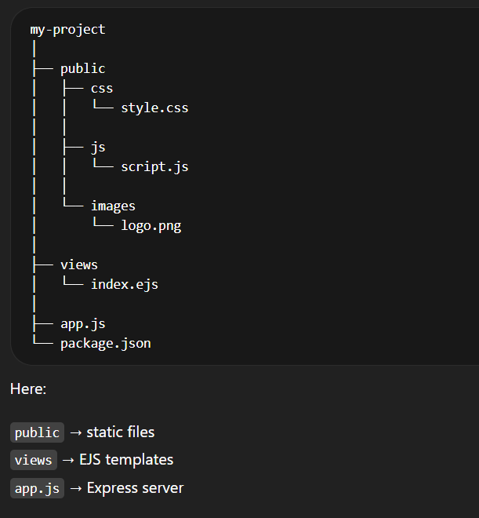
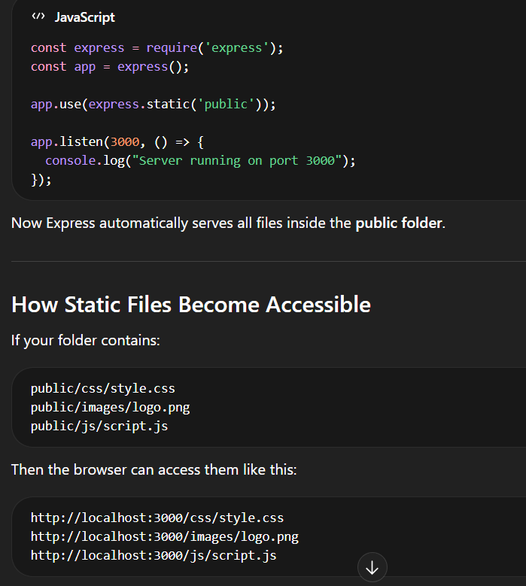

Slide 36
UNIT 2 | Topic 8
async/await in Node.js
Writing clean, readable asynchronous code
MC02094041 – Full Stack Development | MCA Sem 2 | GTU

Slide 37
Synchronous vs Asynchronous Programming
Topic 8 › async/await
📖 Definition: Synchronous (Blocking)
📖 Definition: Asynchronous (Non-Blocking)
Code runs one statement at a time. Each statement WAITS for the previous one to finish before starting. Simple but slow — if one operation is slow, everything else has to wait.
Code starts an operation and moves on WITHOUT waiting for it to finish. When the operation completes, a callback or Promise handles the result. Node.js is built around this approach.
🌍 Analogy — Cooking:
SYNCHRONOUS: Put rice on stove → stand and stare at it for 10 minutes → when done, start vegetables → when done, start curry. Very slow!
ASYNCHRONOUS (Node.js): Put rice on stove → immediately start cutting vegetables → start curry → when rice finishes (event), handle it. All done much faster!
Three Ways to Handle Async Code in JavaScript:
Generation 1
Generation 2
Generation 3
Callbacks
Promises (.then/.catch)
async/await
Functions passed as arguments — gets messy (Callback Hell)
Chainable approach — cleaner but still verbose
Looks like synchronous code — cleanest and modern approach
MC02094041 – Full Stack Development | MCA Sem 2 | GTU

Slide 38
async/await — Definition, Rules & Example
Topic 8 › async/await
📖 Definition: async/await
Syntactic sugar built on top of Promises that allows asynchronous code to be written in a style that looks like synchronous code. 'async' before a function makes it return a Promise. 'await' inside an async function pauses execution until a Promise resolves.
Code Example
Code Example
// OLD WAY — using .then()/.catch()
// Hard to read, deeply nested
getData()
.then(data => {
return processData(data);
})
.then(result => {
return saveData(result);
})
.catch(error => {
console.log('Error:', error);
});
// NEW WAY — async/await
// Clean, readable, easy!
async function run() {
try {
const data = await getData();
const result = await processData(data);
await saveData(result);
console.log('Done!');
} catch (error) {
console.log('Error:', error);
}
}
run();
💡 Note: RULES: (1) 'async' must be placed before the function keyword. (2) 'await' can ONLY be used inside an async function. (3) Always use try/catch to handle errors with async/await.
MC02094041 – Full Stack Development | MCA Sem 2 | GTU

Slide 39
UNIT 2 | Topic 9
Fetching JSON Data from Express
Building APIs that exchange structured data between client and server
MC02094041 – Full Stack Development | MCA Sem 2 | GTU

Slide 40
What is JSON?
Topic 9 › JSON APIs
📖 Definition: JSON (JavaScript Object Notation)
A lightweight, human-readable data interchange format used to transmit structured data between a server and client. JSON uses key-value pairs in curly braces {}. Keys must be strings in double quotes. Values can be string, number, boolean, array, object, or null. JSON has become the universal standard for web APIs.
Code Example
JSON Data Types:
// A JSON object (student record)
{
"name": “Abhi ",
"semester": 2,
"cgpa": 8.75,
"isActive": true,
"address": {
"city": "Surat",
"state": "Gujarat"
},
"subjects": ["FSD","DBMS","OS"]
}
String
"name": “Abhi"
Text in double quotes
Number
"age": 22
Integer or decimal, no quotes
Boolean
"active": true
true or false only
null
"middle": null
Empty / unknown value
Array
"list": [1,2,3]
Ordered list in [ ]
Object
"addr": {}
Nested object in { }
MC02094041 – Full Stack Development | MCA Sem 2 | GTU

Slide 41
What is JSON?
Topic 9 › JSON APIs
📖 Definition: API (Application Programming Interface)
A set of URL endpoints exposed by a server that clients can use to request data (GET), create records (POST), update records (PUT), or delete records (DELETE). APIs typically exchange data in JSON format.
MC02094041 – Full Stack Development | MCA Sem 2 | GTU

Slide 42
Building a Complete JSON API with Express
Topic 9 › JSON APIs
Code Example
API Endpoints Created:
const express = require('express');
const app = express();
app.use(express.json()); // parse body
const students = [
{ id:1, name:'Priya', cgpa:8.75 },
{ id:2, name:'Ravi', cgpa:7.90 },
];
// GET all students
app.get('/api/students', (req,res) => {
res.json(students);
});
// GET one student by ID
app.get('/api/students/:id', (req,res) => {
const s = students.find(
s => s.id === +req.params.id);
s ? res.json(s)
: res.status(404).json(
{ error:'Not found' });
});
// POST — add a new student
app.post('/api/students',(req,res)=>{
const s = req.body;
s.id = students.length + 1;
students.push(s);
res.status(201).json(s);
});
app.listen(3000);
GET
/api/students
Returns ALL students as JSON array
GET
/api/students/:id
Returns ONE student by ID
POST
/api/students
Creates and adds a new student
Code Example
// Browser: fetch the API
const res = await fetch('/api/students');
const data = await res.json();
console.log(data); // JS array
MC02094041 – Full Stack Development | MCA Sem 2 | GTU

Slide 43
Unit 2 — Complete Summary
Summary
# | Topic | What It Does | Key Code / Command
1 | Web Server | Accepts HTTP requests, sends responses | http.createServer() or app.listen()
2 | Node.js | Run JavaScript on the server side | node filename.js
3 | NPM | Install & manage packages | npm install <package-name>
4 | HTTP Module | Built-in basic server creation | require('http')
5 | Express.js | Framework for clean routing & APIs | app.get(), app.post(), app.use()
6 | EJS Templates | Dynamic HTML with server data | res.render('view', { data })
7 | Static Files | Serve CSS, JS, images directly | app.use(express.static('public'))
8 | async/await | Clean asynchronous code | async function + await + try/catch
9 | JSON APIs | Data exchange between client & server | res.json(data) + fetch('/api/...')
MC02094041 – Full Stack Development | MCA Sem 2 | GTU

Slide 44
Important Definitions — Exam Preparation
Exam Prep
Web Server:
Software that accepts HTTP requests and sends responses (HTML, JSON, files)
EJS:
Embedded JavaScript — template engine for generating dynamic HTML on the server
HTTP:
HyperText Transfer Protocol — rules for client-server communication on the web
SSR:
Server-Side Rendering — HTML is built on the server before being sent to browser
Node.js:
Open-source, server-side JavaScript runtime built on Chrome's V8 engine
Static Files:
Files (CSS, images, JS) served as-is without any server-side processing
NPM:
Node Package Manager — installs and manages JavaScript libraries/packages
async/await:
Modern syntax to write asynchronous code that reads like synchronous code
package.json:
Project config file that stores name, version, and all dependencies list
Promise:
Object representing the eventual result (success or failure) of an async operation
Express.js:
Minimal, fast Node.js web framework for routing, middleware, and APIs
JSON:
JavaScript Object Notation — lightweight key-value data format for web APIs
Routing:
Deciding how the server responds to a request based on URL path and HTTP method
API:
Set of URL endpoints a server exposes for clients to request or send data
Middleware:
Function in Express that processes requests between receiving and responding
Port:
Number (0–65535) identifying a specific service/process on a computer
MC02094041 – Full Stack Development | MCA Sem 2 | GTU

Slide 45
REFERENCES
https://www.codecademy.com/article/what-is-express-js
https://www.codecademy.com/resources/docs/general/node-js https://www.codecademy.com/article/node-package-manager
https://www.npmjs.com/
https://ejs.co/
https://github.com/mde/ejs/wiki/Using-EJS-with-Express
MC02094041 – Full Stack Development | MCA Sem 2 | GTU

Slide 46
UNIT 2 👍
Any Questions?
Practice every code example in your terminal. Programming is learned by doing, not by reading or watching.
MC02094041 – Full Stack Development | MCA Semester 2 | GTU

